Slide 1
Exposure to Violence and a Child’s Development
Stephen J. Bavolek, Ph.D.
Family Nurturing Center
Asheville, NC

Slide 2
Nature vs Nurture
Nature:
The genetic predispositions we are born with.
Nurture:
The environment’s impact upon our genetic predispositions

Slide 3
Nature vs Nurture
Common findings in research:
80% of our personality is developed from the way we are treated during our process of growing up (nurture).
20% of our personality comes from our nature.

Slide 4
Human behavior is multi-dimensional.
The positive and negative impact of life’s past events shape our cognitive, emotional and neurological responses to current events.

Slide 5
Personality Development
Events develop our personality characteristics. (prevention)
Personality characteristics lead to the development of personality traits. (intervention)
Over time, personality traits lead to full blown personalities. (treatment)

Slide 6
Nurturing Parenting
Insight leads to choices
Choices lead to changes
Changes lead to liberation James Hollis, The Middle Passage

Slide 7
Human Brain
“The brain is the most complex thing we have yet discovered in our universe.”
James Watson, Nobel Prize for helping discover DNA
Woody Allen mentions that
“…the brain is my second most favorite organ.”

Slide 8
Recent discoveries in brain functioning:
that brain cells carry an emotional memory in addition to a cognitive memory.
the more negative or positive images of your self, the more those thoughts become “normalized”
images form neural pathways, and become the story of that person.

Slide 9
Philosophy of Nurturing Parenting
Positive nurturing is nourishing the aspects of life we want.
Negative nurturing is nourishing the aspects of life we don’t want, but get anyway.

Slide 10
Decades of behavioral research
Positive, healthy nurturing in childhood is related to subsequent healthy lifestyles
negative, destructive nurturing in childhood is related to subsequent unhealthy lifestyles.

Slide 11
Positive Nurturing
Positive nurturing is called EMPATHY which
Comes from the Greek word
empatheia
Empathy is one of the most important characteristics of a nurturing parent.

Slide 12
Empathy
The ability to imagine yourself in someone else’s position and to intuit what that person is feeling.
to project into or identify with another.
to enter fully through understanding another’s feelings or motives.
To stand in someone’s shoes, to see what they see, to hear what they hear, and to feel with your heart.

Slide 13
Negative Nurturing
Negative nurturing is called
abuse and neglect.
The word abuse comes from the Latin word
abusus
which means to mistreat; cruel and harsh punishment.

Slide 14
Negative Nurturing
Neglect comes from the Latin word
neglegere
neg means “not” and
legere means “pick up.”
Neglectful parenting means not holding or touching children.

Slide 15
Frequency and Intensity of
positive and negative
nurturing experiences created in Childhood
influence our behavior through neurological networks
and pathways

Slide 16
Continuum of Caring
Positive Nurturing (Empathy)
Frequency Always Frequent Sometimes Infrequent Never
Intensity Very High High Average Low Not Present
10 9 8 7 6 5 4 3 2 1 0
Negative Nurturing (Abuse and Neglect)
Frequency Never Infrequent Sometimes Frequent Always
Intensity Not Present Low Average High Very High
0 1 2 3 4 5 6 7 8 9 10

Slide 17
Philosophy of Nurturing
Alice laughed, “There’s no use in trying,” she said. “One can’t believe in impossible things.”
“I daresay you haven’t had much practice,” said the queen. “When I was your age I always did it for half an hour a day. Why sometimes I’ve believed as many as six impossible things … before breakfast.”
- Lewis Carroll

Slide 18
Childhood Hours
The following chart displays how personalities and behavior patterns are influenced early in life based on the quality of life in childhood portrayed in hours.
There are approximately
157,776 hours
in the first 18 years of life.

Slide 19
157,776 Hours in Childhood
Positive % Negative % Dysfunctional Hours
20% 80% 126,221
30% 70% 110,443
50% 50% 78,888
70% 30% 47,333
80% 20% 31,555
90% 10% 15,778
95% 5% 7,889
99% 1% 1,578
100% 0% 0

Slide 20
Childhood Mental Illness
A high frequency and intensity of negative nurturing develop abusive and neglecting
Personality Characteristics
Personality Traits
Full Blown Personalities

Slide 21
Negative Nurturing Experiences
Stress caused by negative nurturing experiences produce stress hormones cortisol and adrenaline
Brain is normalizing dysfunction
Diseased neurological networks and pathways are developed

Slide 22
Childhood Mental Illness
When stress hormones are overactive, they can take over genetic regulation creating aberrant networks of connections between brain cells.

Slide 23
Childhood Mental Illness
* Depressive episodes occur instead of a happy thoughts;
* A surge of rage occurs instead of willingness to compromise.

Slide 24
Childhood Mental Illness
Abusive environments can cause genes important for survival to become overexposed making a person more aggressive and violent.

Slide 25
Dysfunctional Personalities
Two dysfunctional personality characteristics are formed and reinforced.
Over time, these characteristics lead to traits which can lead to full blown adult personalities.

Slide 26
Dysfunctional Personalities
Perpetrator
The part of our personality that is abusive, hurts others:
physically emotionally spiritually sexually
generally disregards the overall goodness of other living creatures.

Slide 27
Dysfunctional Personalities
Victim
The part of our personality that believes:
* hurt and pain given by others is justified and valid
* hurt received from others is for their own good
* people who love you can hurt you
* they need to feel grateful to others for their victimization.

Slide 28
Childhood Mental Health
Positive nurturing in the form
empathy empowerment
positive discipline self-worth
create
healthy neurological networks and pathways.

Slide 29
Childhood Mental Health
  The healthy aspects of life give birth to functional behavior, which strengthen into two positive character traits and personalities.

Slide 30
Childhood Mental Health
Nurturer
The part of our personality that
Is capable of giving care, empathy and compassion
Takes care of one’s self as well as the selves of others
Builds strong attachments with children, family, friends and pets

Slide 31
Childhood Mental Health
Nurtured
The part of our personality that is capable of:
receiving care
seeking closeness
accepting attachments
accepts praise and positive touch.

Slide 32
Spiritual Beings Seeking Humanity
Philosophers have subscribed to the belief that humans seek pleasure and meaning in life while avoiding pain.

Slide 33
The Two Wolves
Native American Wisdom
Family Development Resources, Inc.
Publishers of the Nurturing Parenting Programs®
Visit our Website at www.nurturingparenting.com

Slide 34
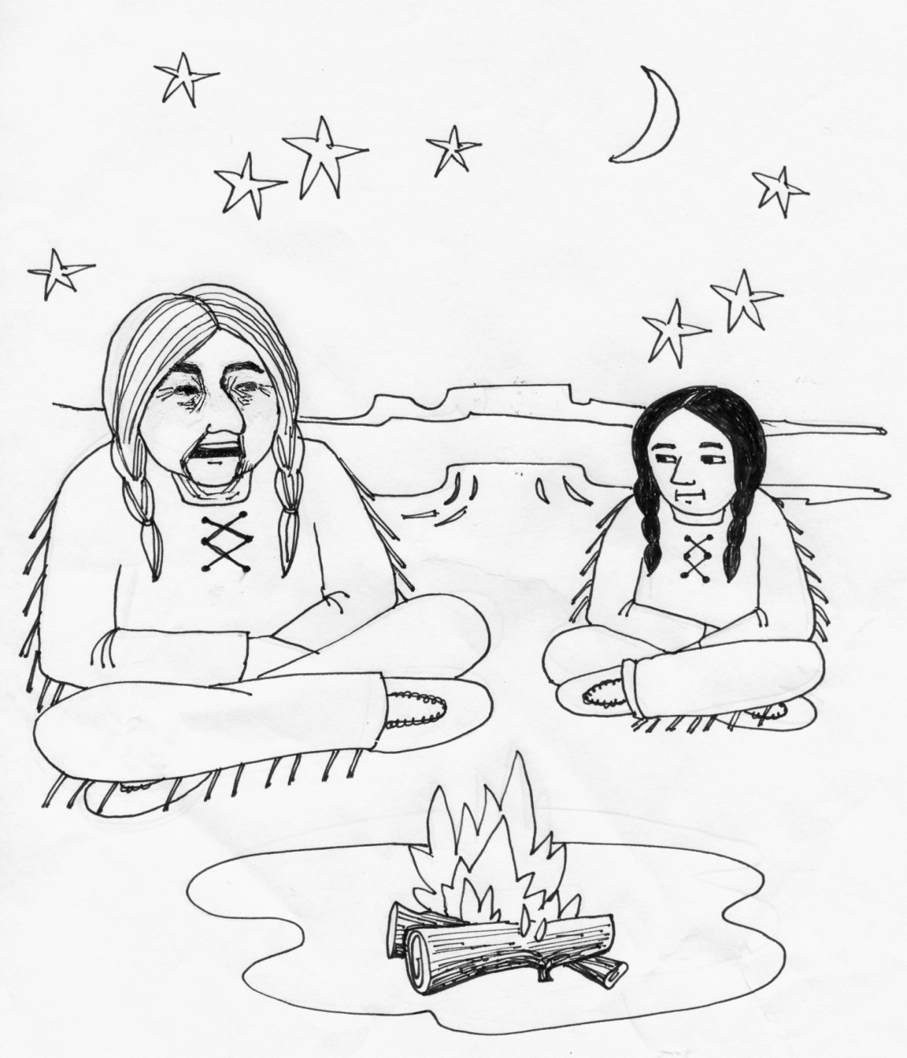
“An elder Cherokee Native American was teaching his grandchild about life. He said to his grandchild …

Slide 35
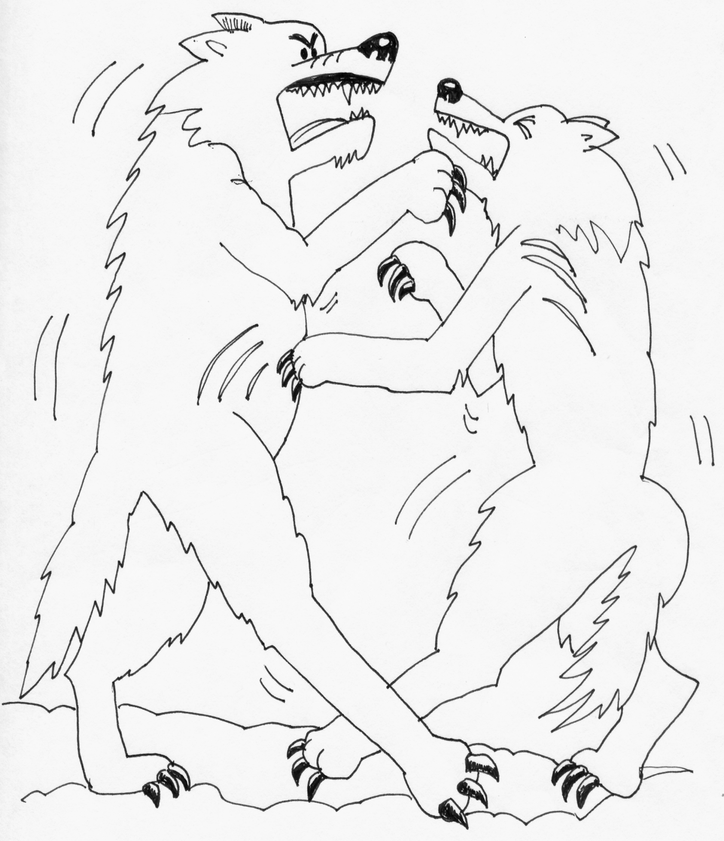
“A fight is going on inside of me … and it is a terrible fight and it is between two wolves.

Slide 36
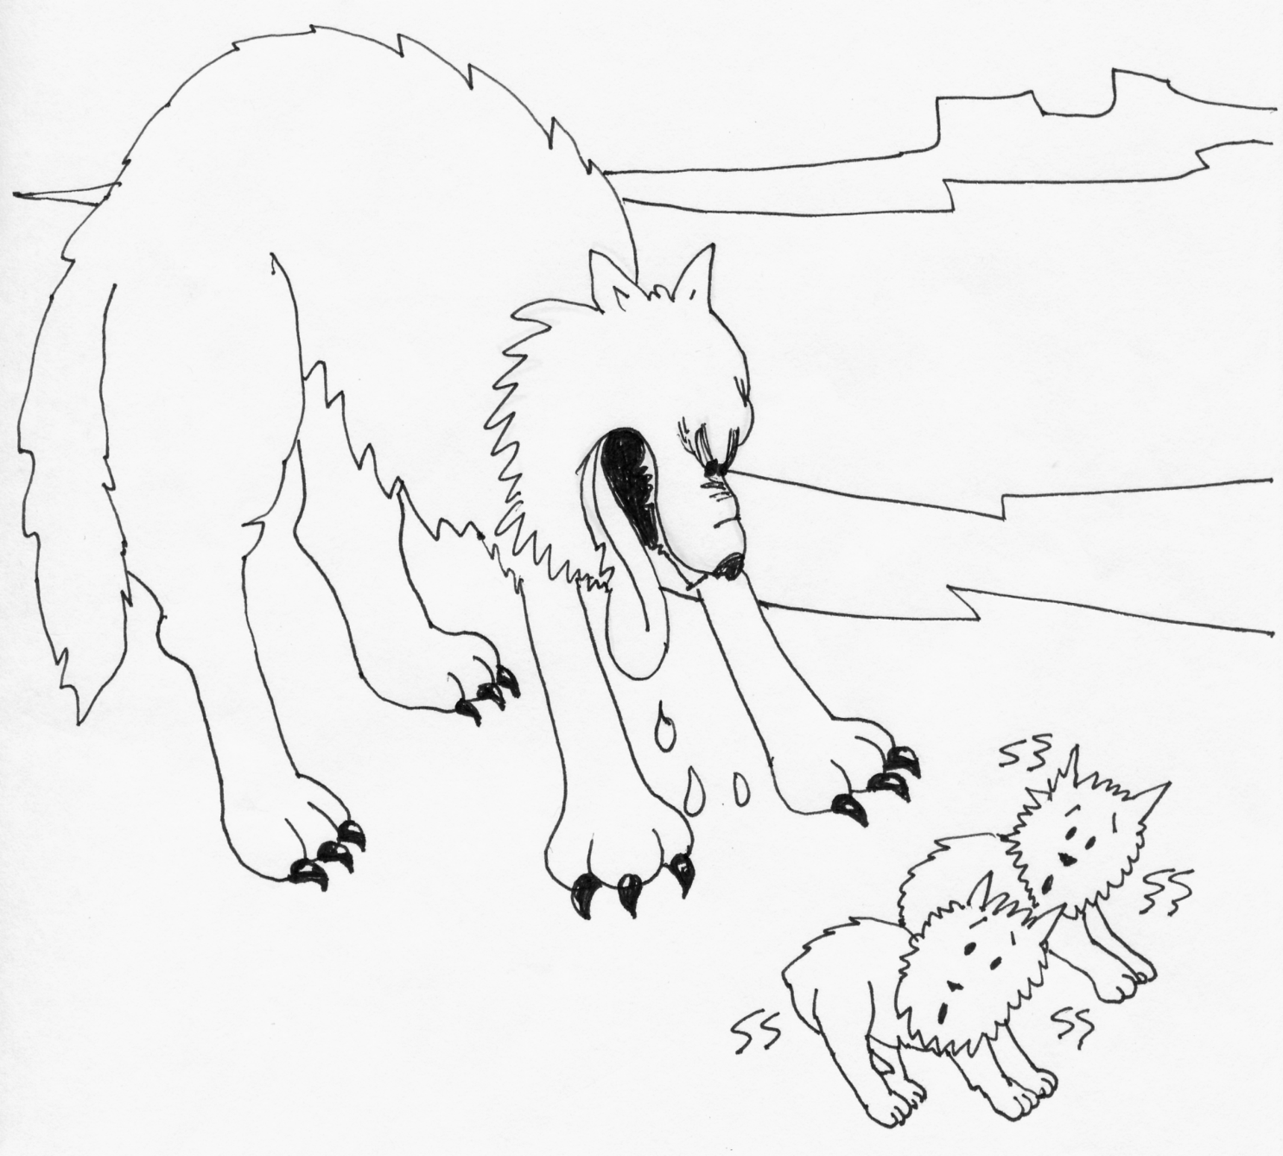
One wolf represents fear, anger, envy, sorrow, regret, greed, arrogance, self-pity, guilt, resentment, inferiority, lies, false pride, superiority and ego.

Slide 37
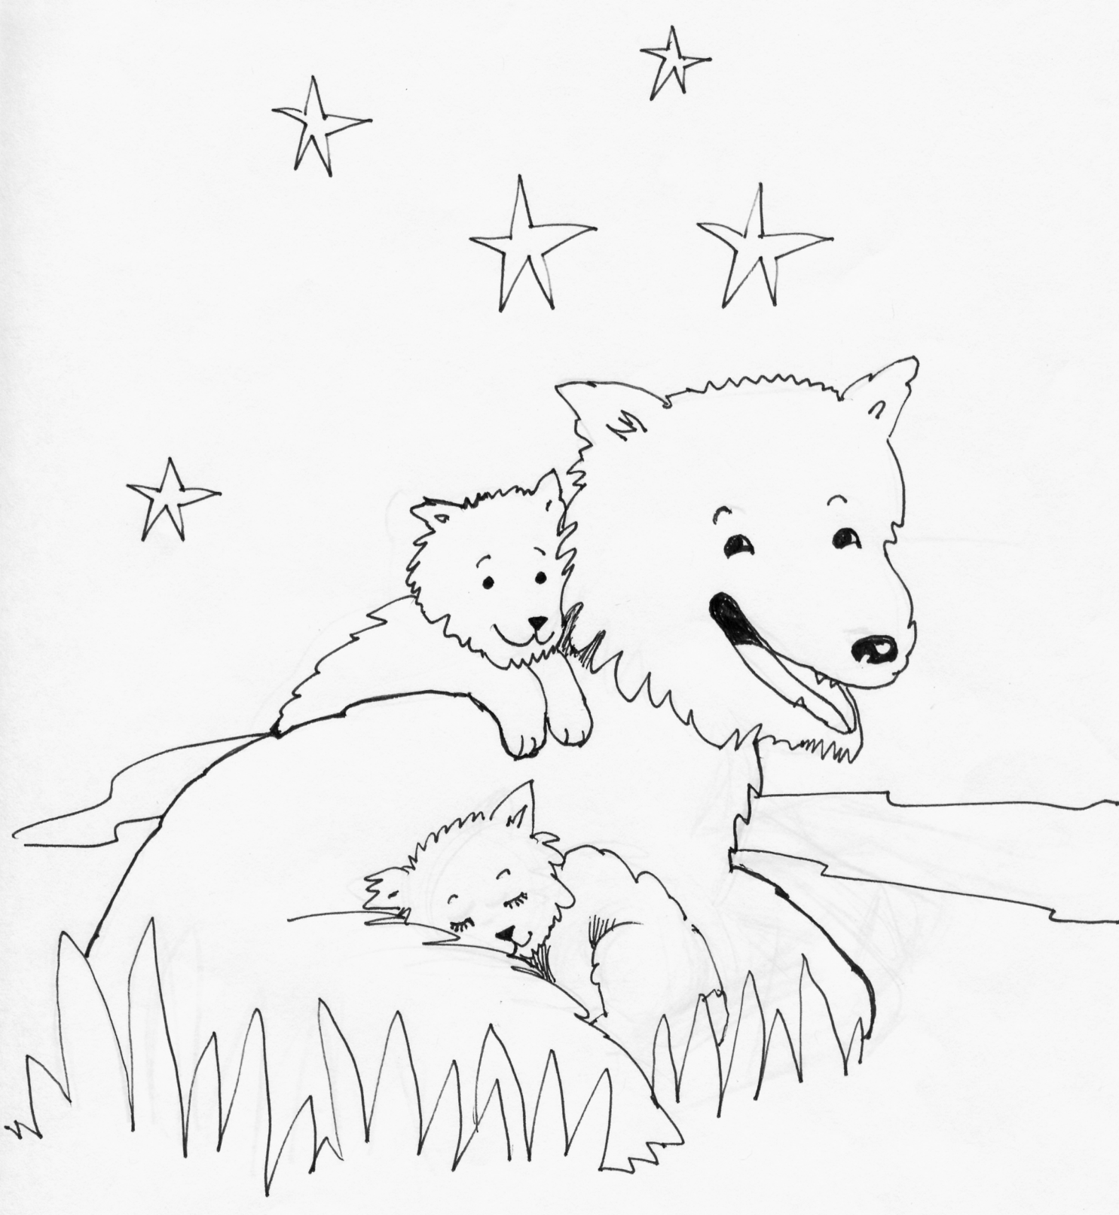
The other wolf stands for honor, joy, peace, love, hope, sharing, serenity, humility, kindness, benevolence, friendship, empathy, generosity, truth, compassion, and faith.

Slide 38
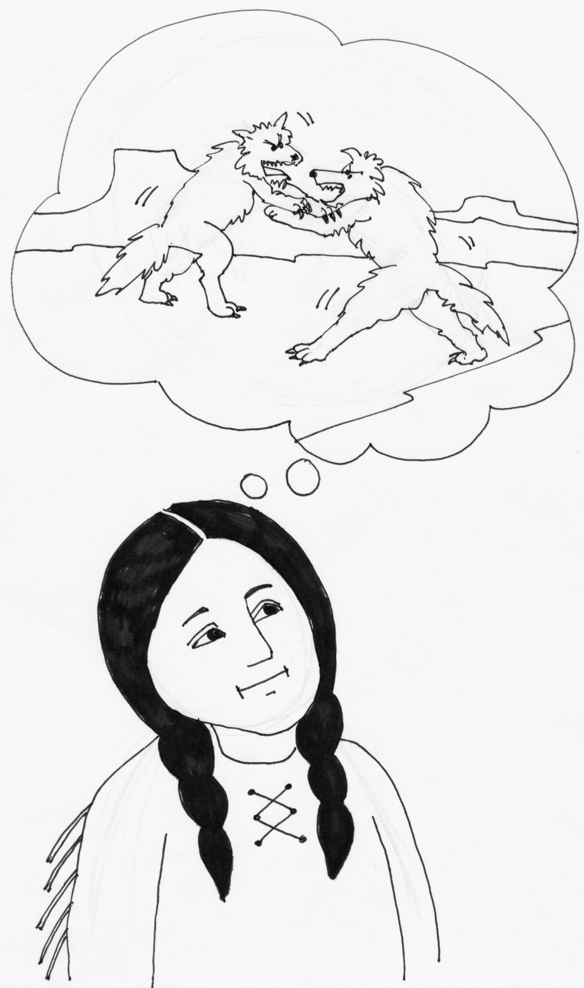
The same fight is going on inside of you and inside of every other human being too.”

Slide 39
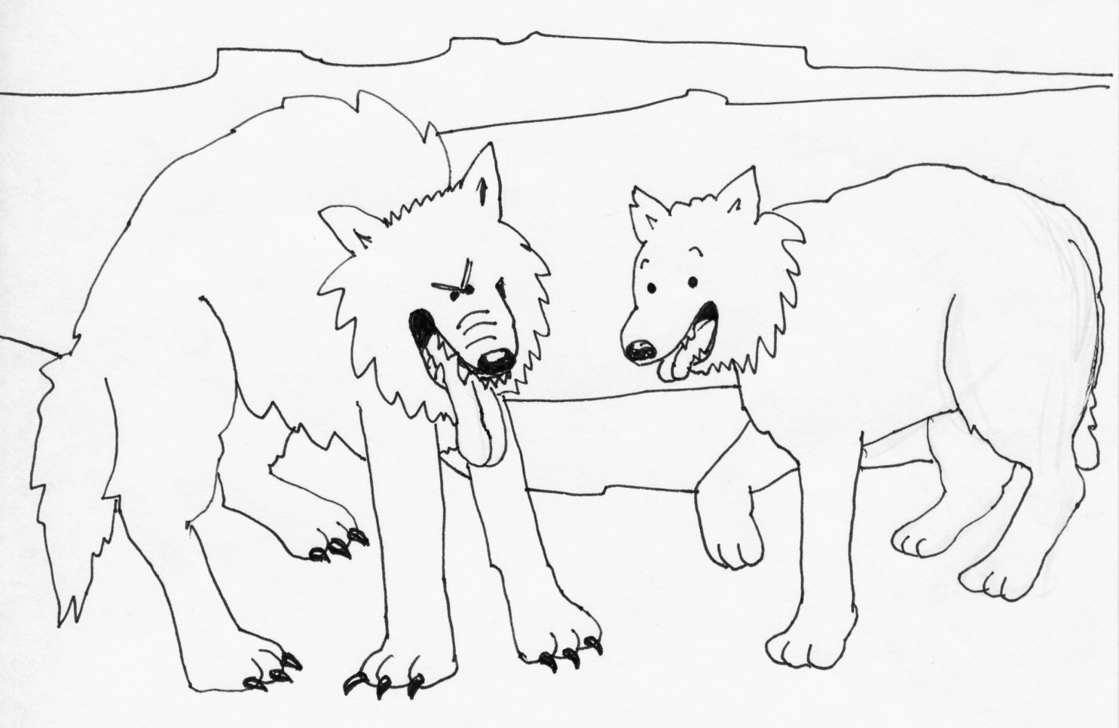
After thinking about it for a minute or two, the grandchild asked her grandfather, “Which wolf will win”?

Slide 40
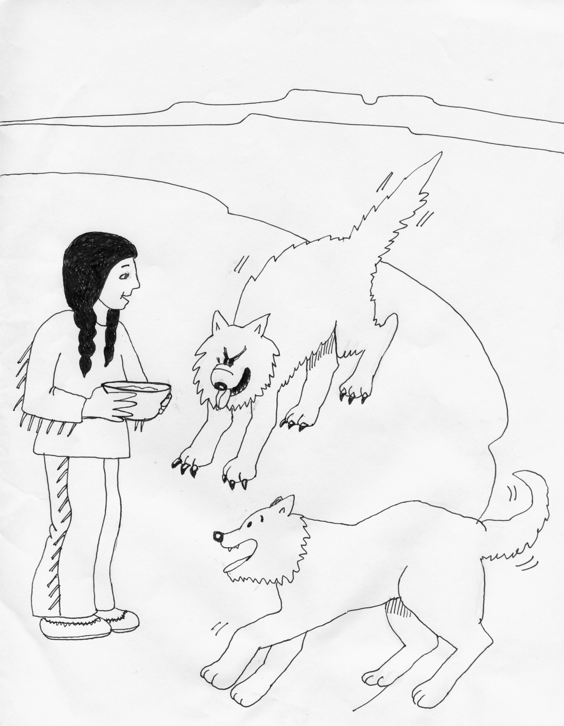
The old man leaned toward his grandchild and whispered …
“The one you feed.”

Slide 41
Childhood Mental Health
Self Concept: The thoughts people have about themselves.
Self Esteem: The feelings people have about themselves.
Self Worth: The overall thoughts and feelings that people have of themselves.

Slide 42
What is Child Abuse and Neglect
Negative Nurturing
The following constructs identify the known parenting practices and child rearing behaviors of abusive and neglecting parents.
The Nurturing Parenting Programs are designed to treat and prevent these practices from occurring.

Slide 43
Inappropriate Expectations
Beginning very early in the infant’s life, abusive parents tend to inaccurately perceive the skills and abilities of their children.
Effects:
Low regard for self (concept, esteem, worth)
Feelings of failure
Cannot please others
Angry and anxious attachments

Slide 44
Empathic Parents
Empathic parents are:
sensitive to their children’s needs
create a caring environment that is conducive to promoting children’s emotional, social, intellectual, physical, spiritual, and creative growth.

Slide 45
Parental Lack of Empathy
Diminished ability to trust
Inability to form strong attachments
Difficulty in taking care of one’s self
Develops clingy relationships
Focus is on self
Possessive and smothering relationships
Fears of abandonment
Easily led
Difficulty in accepting positive recognition

Slide 46
Strong Belief in Corporal
Punishment
Physical punishment is generally the preferred means of discipline used by abusive parents.
Throughout history, the use of corporal punishment has been well documented.

Slide 47
Why Parents Hit their Children
Parents hit children to teach them right from wrong.
Parents hit children as a form of punishment.
Parents hit children based on religious writings.
Parents hit children as an “act of love.”
Parents hit children because it’s a cultural practice.
Parents hit children to prepare them for the real world

Slide 48
Parent-Child Role Reversal
Parent-child role reversal is an interchanging of traditional role behaviors between a parent and child, so that the child adopts some of the behaviors traditionally associated with parents.

Slide 49
Oppressing Power & Independence
When children’s power and independence are oppressed they are not allowed:
NOT to challenge,
NOT to voice opinions,
NOT to have choices,
but rather are told
“do what you are told to do”
without question.

Slide 50
Obedience vs Cooperation
This demand for compliance to parental authority has many limitations:
Obedience breeds powerlessness.
Obedience breeds inadequacy.
Obedience also breeds rebelliousness.
Obedience breeds compliance — to all.
Obedience breeds followers, not leaders.

