Slide 1
AAPI-2 and the NSCS: Assessment, Evaluation and Research for Program Effectiveness Stephen J. Bavolek, Ph.D.
The Nurturing Parenting Programs®
Creating a Caring World Through Nurturing
Notes:
#1

Slide 2
Assessments
AAAPI-2: the Adult-Adolescent Parenting Inventory
NSCS: the Nurturing Skills Competency Scales

Slide 3
Program Assessment and Evaluation Assessing Parenting Beliefs, Attitudes and Knowledge
PRE Before the program begins. Pretest data are gathered during the first session to assess entry level skills.
PROCESS During the Program. Process data are gathered during the program to monitor the success rate of the families.
POST After the program ends. Posttest data are gathered during the last session of the program to assess exit level skills and knowledge.
Workbook pg. 34

Slide 4
Pre and Posttest Data
1. Adult-Adolescent Parenting Inventory (AAPI-2)
2. Nurturing Skills Competency Scale (NSCS)
3. Parenting Attitudes Raising Teens Inventory (PARTI).
Workbook pg. 34

Slide 5
Process Data
1. Family Nurturing Plan (Staff)
2. Attendance Log
3. Home Practice Assignments
4. Family Nurturing Journal (Parents)
5. Session Competency and Evaluation Forms
Workbook pg. 34

Slide 6
Adult-Adolescent Parenting Inventory
The AAPI-2 is an inventory designed to assess the parenting and child rearing beliefs of adult and adolescent parent and pre-parent populations.
Workbook pg. 35

Slide 7
Nurturing Skills Competency Scale
The NSCS is a criterion referenced inventory designed to assess parenting knowledge and skills along with family conditions and characteristics that can support or challenge the parenting education being taught to the family.

Slide 8
Parenting Beliefs
Perceptions Cognition
(thoughts)
Beliefs
Emotions Social
Consensus

Slide 9
Parenting Beliefs
Perceptions: All the information we receive about ourselves through our senses.
Cognition: All the abstract conceptual processes that our brain uses to organize and make sense of our perceptions which include memories and unconscious thoughts.
Emotions: Help us establish the intensity and value of every perceptual and cognitive experience we have.
Social Consensus: The input we receive from others that is important for the beliefs to emerge into consciousness.
Daniel Newberg

Slide 10
Nearly1 million inventories administered during the past 35 years
Successful Administration of the Adult-Adolescent Parenting Inventory® AAPI-2

Slide 11
Adult-Adolescent Parenting Inventory
The AAPI-2 is made up of five “Constructs” that form the items and subscales:
Construct A Inappropriate Expectations of Children
Construct B Inability to Demonstrate Empathy towards Children’s Needs
Construct C Strong Parental Belief in the Use of Corporal Punishment
Construct D Reversing Parent-Child Family Roles
Construct E Oppressing Children’s Power and Independence

Slide 12
Adult- Adolescent Parenting Inventory
Responses to the AAPI-2 provide and index of risk for practicing parenting behaviors in each of the five parenting constructs.
Responses fall into three levels of risk:
Low
Moderate
High

Slide 13
Validity and Reliability of AAPI-2
Abusive parents (male and female) express significantly (p<.001)more abusive beliefs than non-abusive parents (male and female).
Workbook pg. 36

Slide 14
Validity and Reliability of AAPI-2
Males, regardless of status (abusive or non-abusive) express significantly (p<.001) more abusive parenting beliefs than females.
Workbook pg. 36

Slide 15
Validity and Reliability of AAPI-2
Adolescents (male and female) with histories of being abused express significantly (P<.001) more abusive parenting beliefs than non-abused adolescents (male or female).
Workbook pg. 36

Slide 16
Validity and Reliability of AAPI-2
Male adolescents express significantly (P<.001) more abusive parenting beliefs than female adolescents.
Workbook pg. 36

Slide 17
Validity and Reliability of AAPI-2
Adolescents, both male and female express significantly (p<.001) more abusive parenting beliefs than adults, both male and female.

Slide 18
Validity and Reliability of AAPI-2
Each of the five parenting constructs of the AAPI-2, forming the five sub-scales of the inventory, show significant diagnostic and discriminatory validity.
Workbook pg. 36

Slide 19
Sample Demographic Page

Slide 20
Sample Test Form B, Page 1

Slide 21
Sample Test Form B, Page 2

Slide 22
AAPI Parenting Profiles PRE TEST
The following are samples of
PRE TEST
AAPI-2 Parenting Profiles

Slide 23
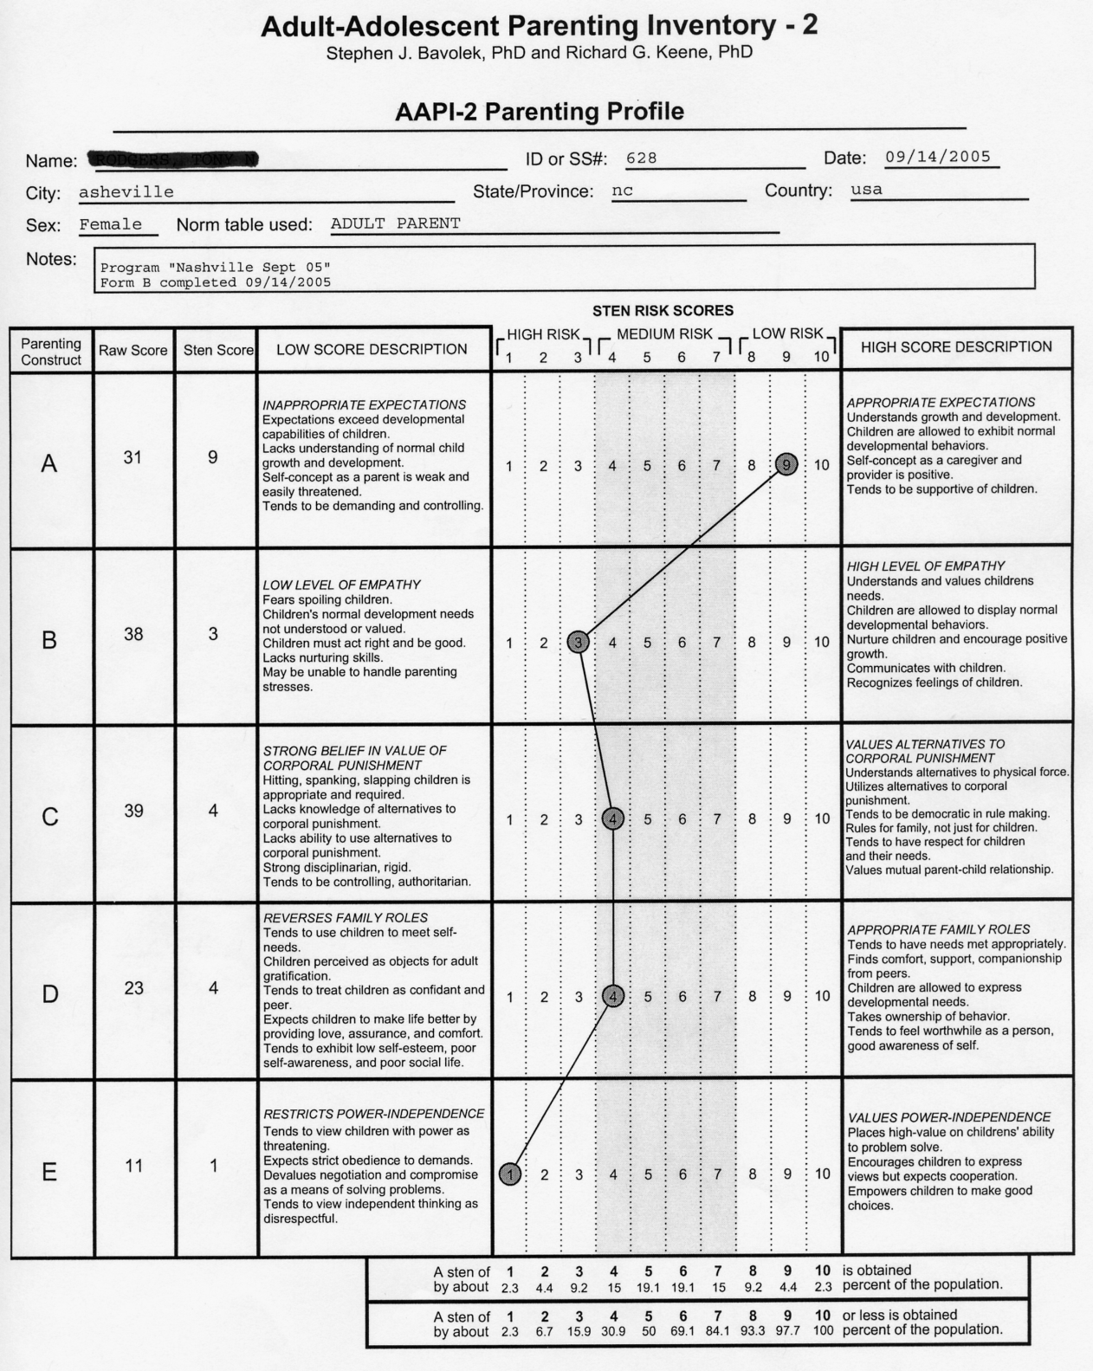
Pretest Profile #1

Slide 24
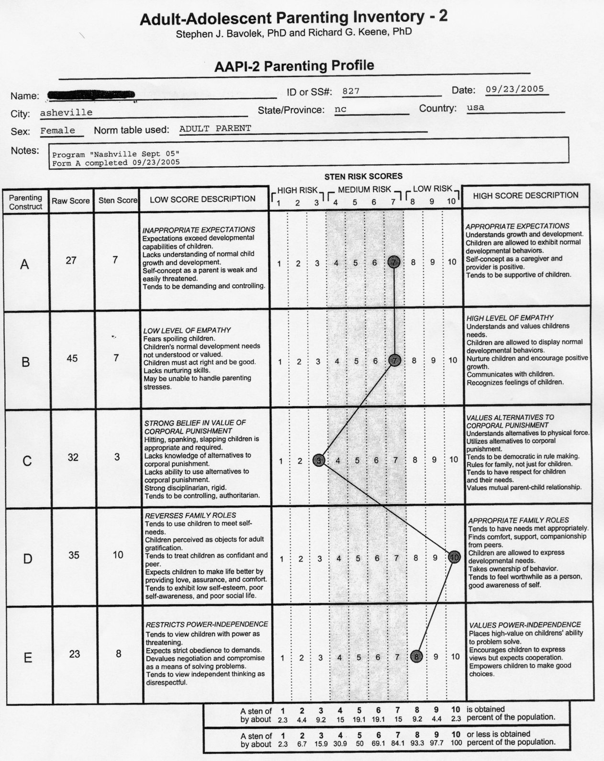
Pretest Profile #2

Slide 25
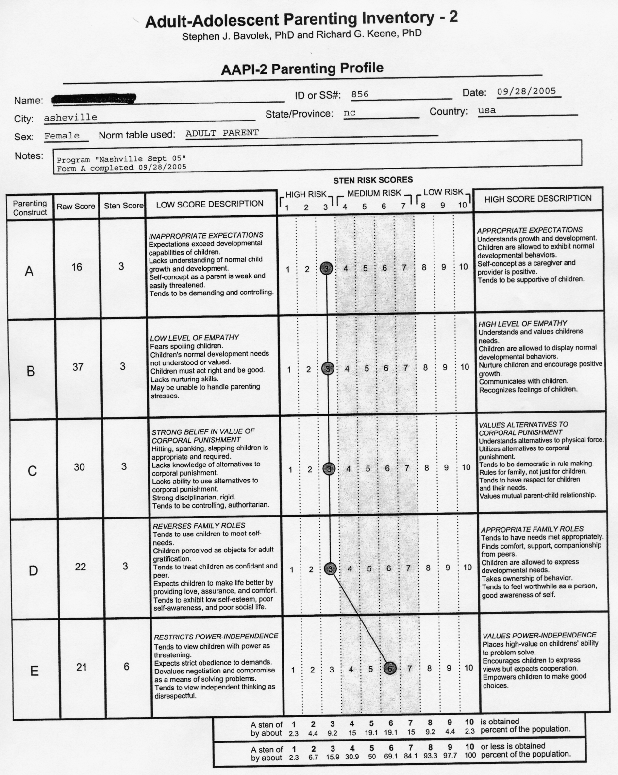
Pretest Profile #3

Slide 26
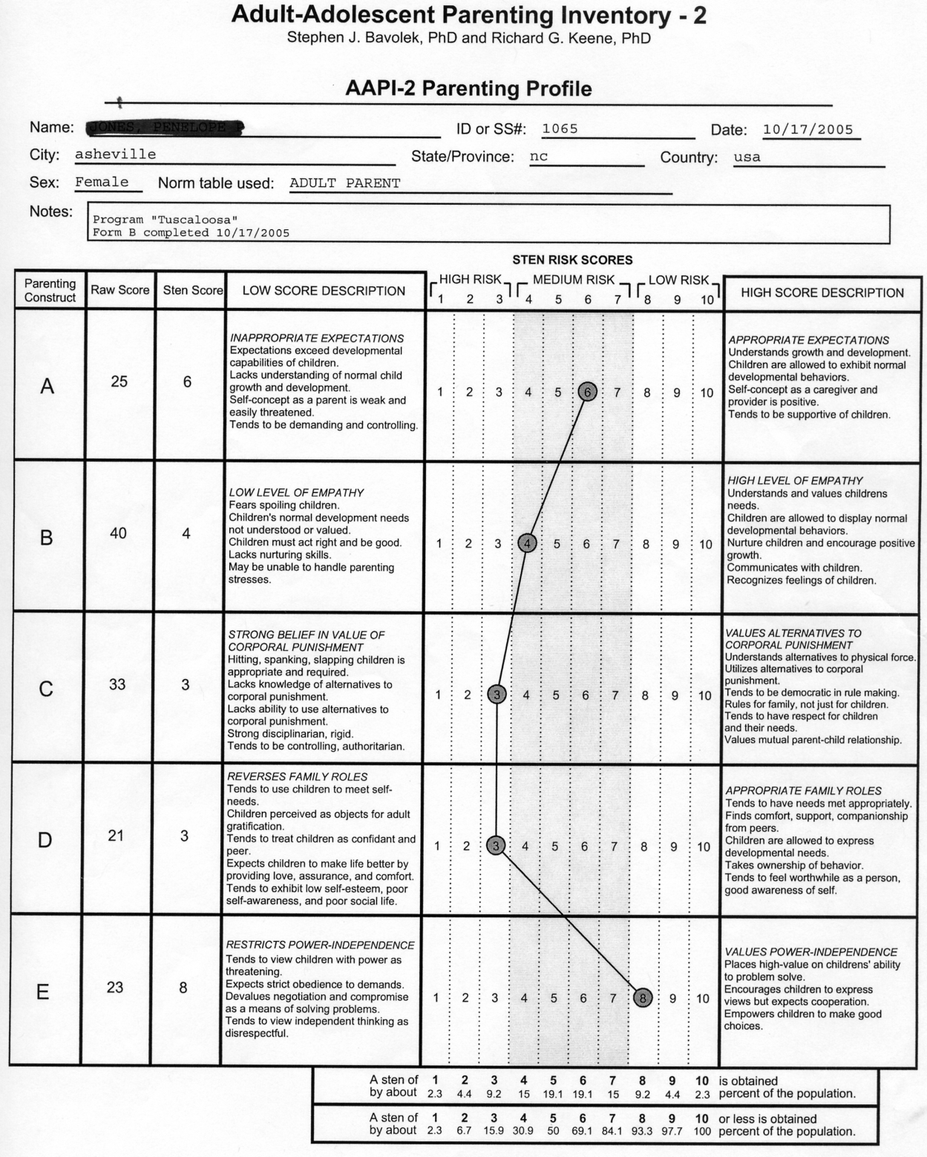
Pretest Profile #4

Slide 27
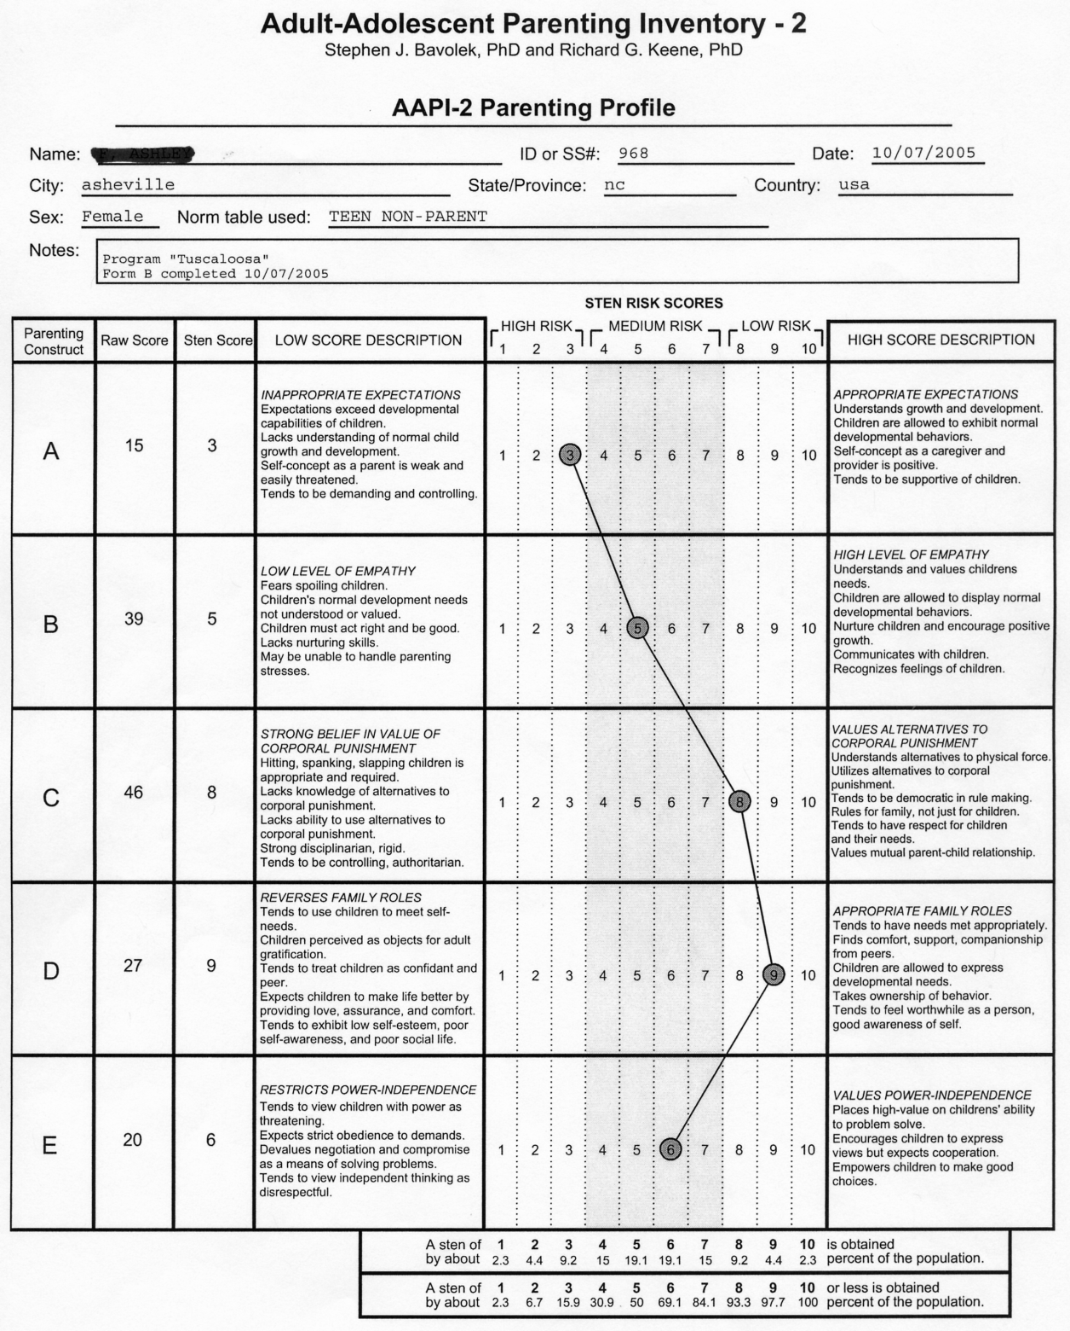
Pretest Profile #5

Slide 28
AAPI Parenting Profiles POST TEST
The following are samples of
POST TEST
AAPI-2 Parenting Profiles

Slide 29
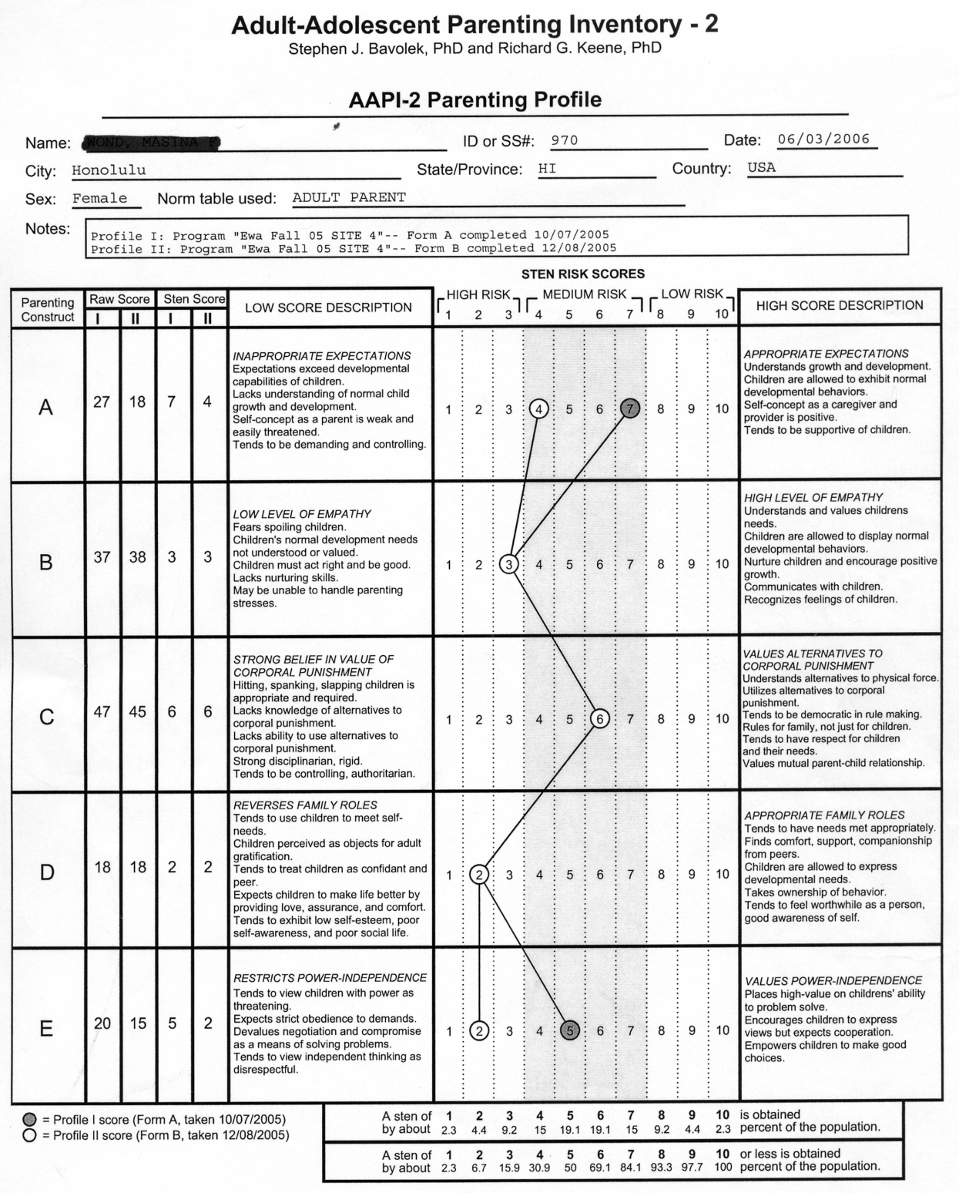
Pre and Posttest Profile #1

Slide 30
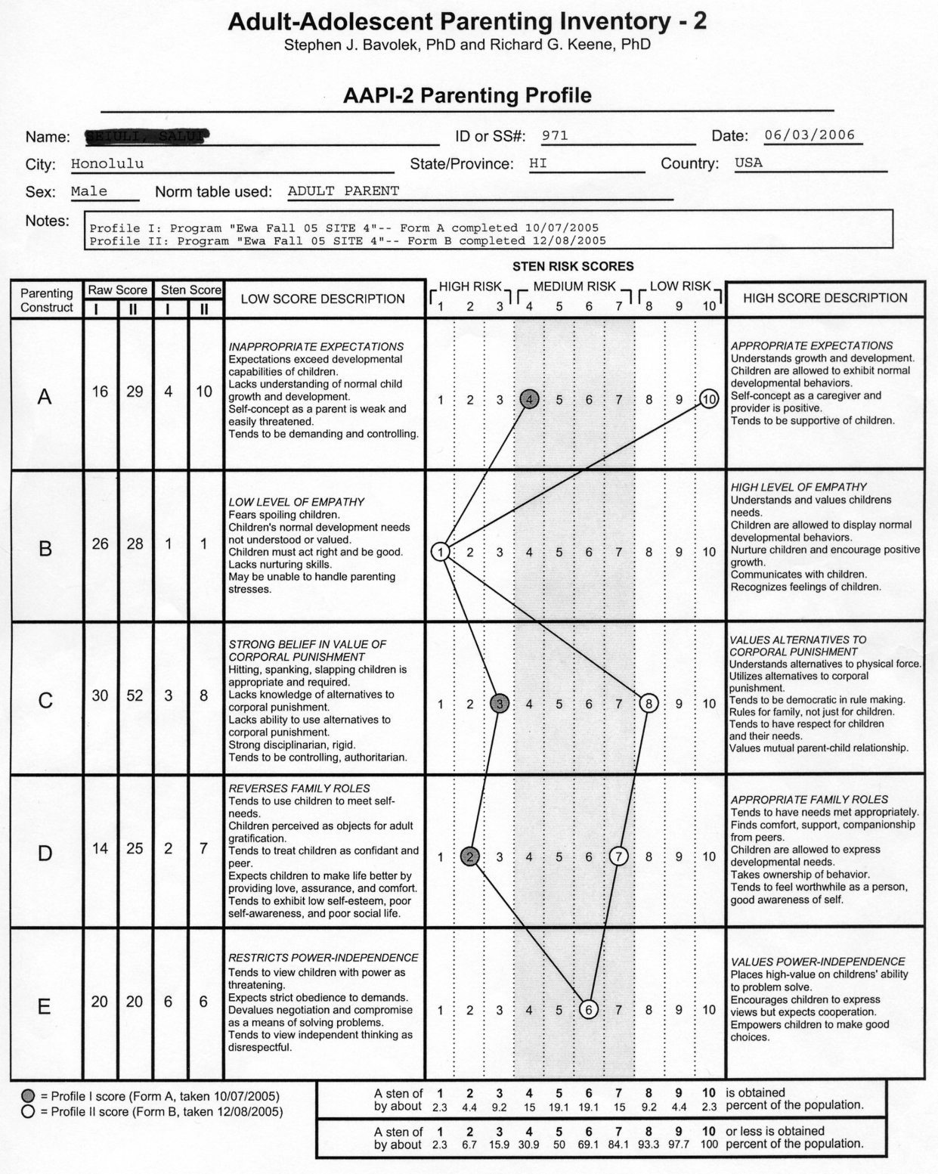
Pre and Posttest Profile #2

Slide 31
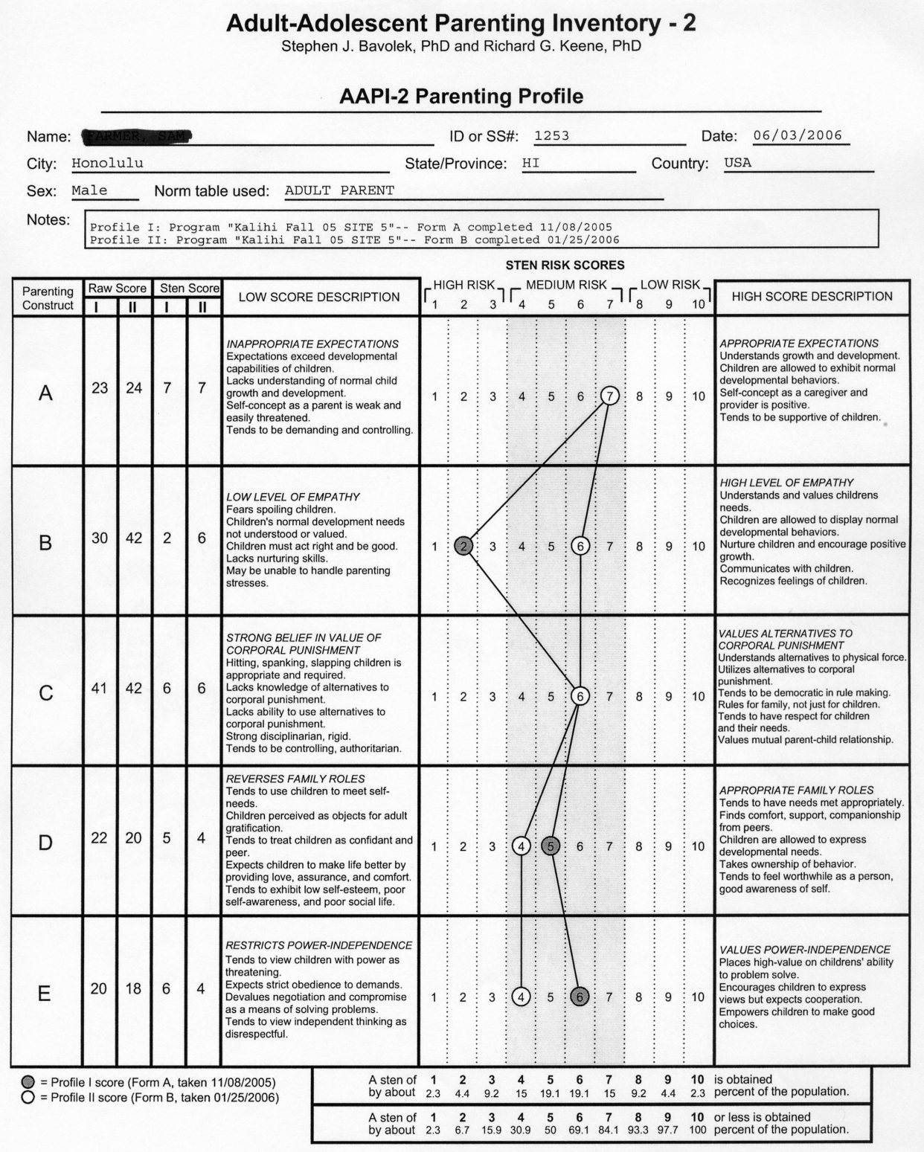
Pre and Posttest Profile #3

Slide 32
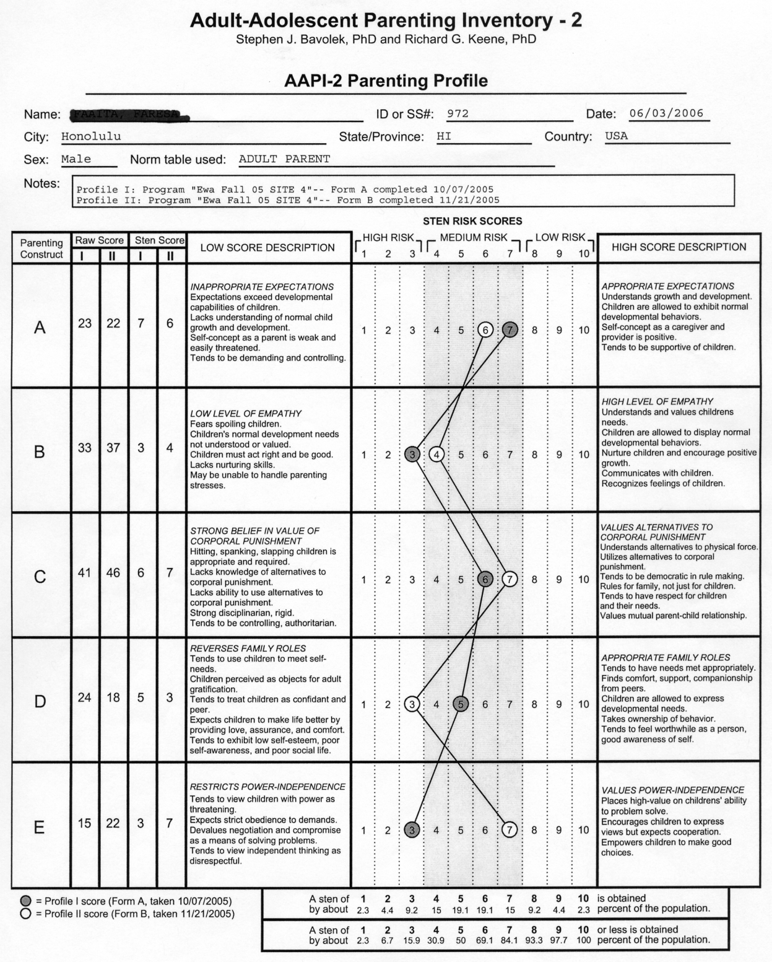
Pre and Posttest Profile #4

Slide 33
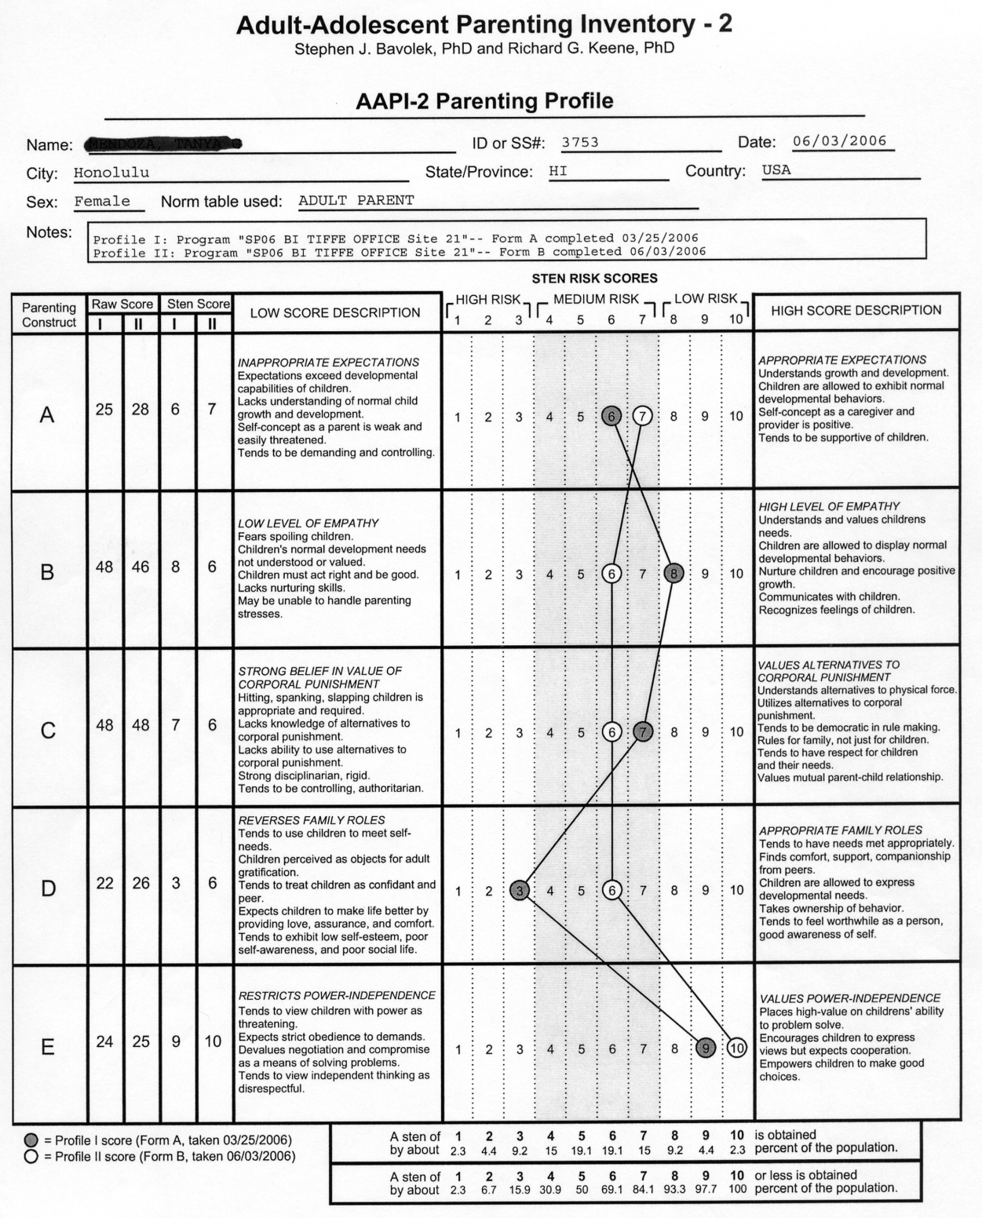
Pre and Posttest Profile #5

Slide 34
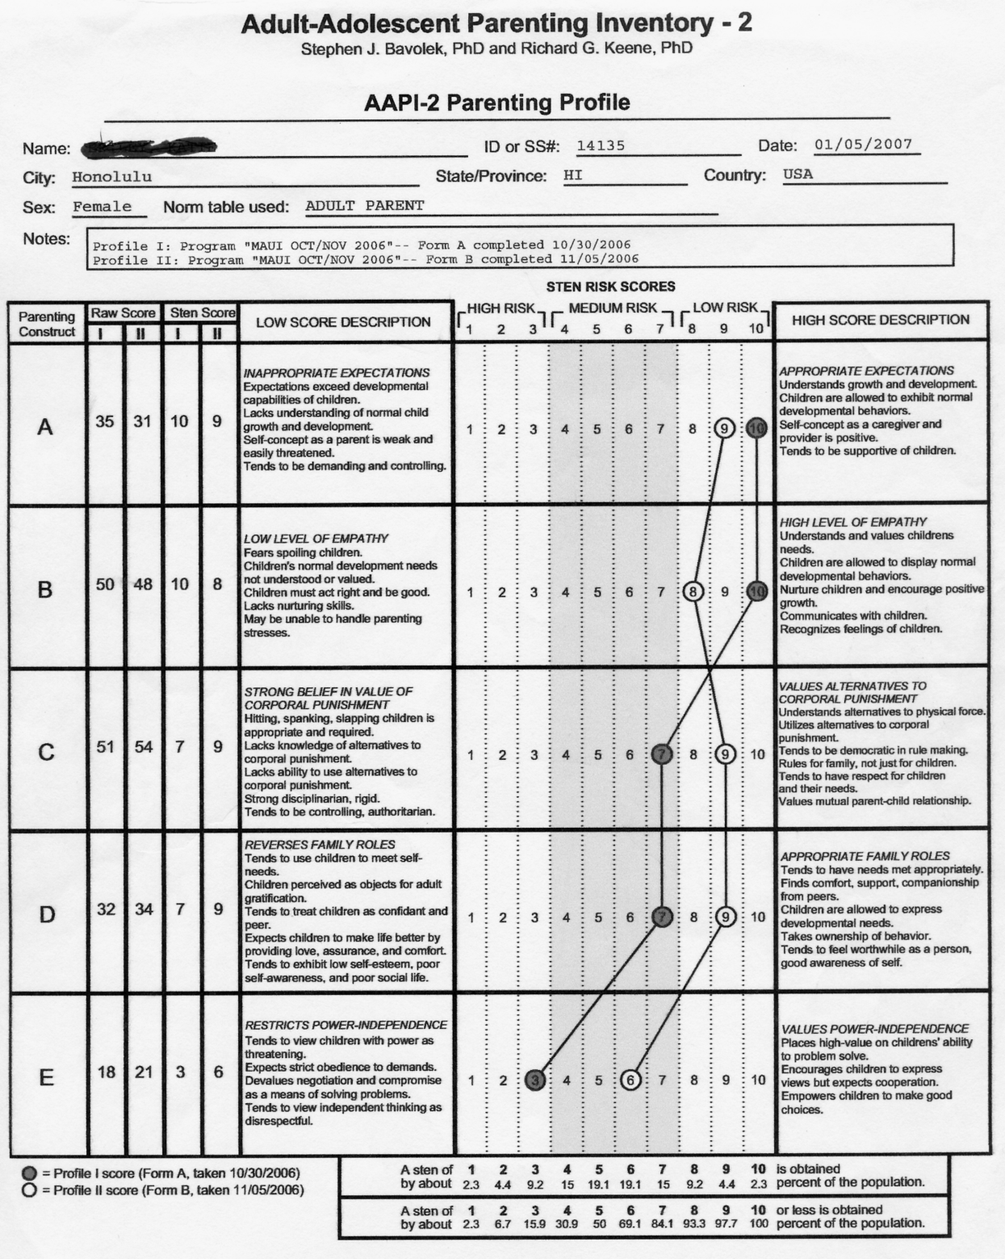
Pre and Posttest Profile #6

Slide 35
Adult-Adolescent Parenting Inventory (AAPI-2)
Use of AAPI-2 Information
To provide pretest or posttest data to measure treatment effectiveness.
To assess the parenting and child rearing attitudes of parents and adolescents prior to parenthood
To design specific treatment and intervention parenting education programs.
To design nurturing experiences for parents and adolescents whose attitudes indicate a high risk for child maltreatment
To screen foster parent applicants, child care staff, and volunteers for education and training purposes.
Workbook pg. 35

Slide 36
Benefits of AAPI OnLine
Administer and Score the AAPI OnLine Anytime.
Cost Savings
Accuracy
Data Privacy
Data Export
Individual and Group Profiles
Manage Data by Program
Clinical Interpretation of Parenting Profiles
Download Test Forms
One-Year Free Data Storage

Slide 38
Successful Administration of the Nurturing Skills Competency Scale NSCS
Stephen J. Bavolek. Ph.D.

Slide 39
Nurturing Skills Competency Scale NSCS
The NSCS is a self report, criterion referenced measure design to gather data in six areas:
Subscale A: About Me
Subscale B: About My Childhood
Subscale C: About My Spouse (Partner)
Subscale D: About My Children and Family
Subscale E: My Knowledge of Nurturing Parenting
Subscale F: My Utilization of Nurturing Skills

Slide 40
Purpose of the NSCS
Data generated from the six Constructs of the NSCS have been recognized as contributing to child maltreatment and family dysfunction.
New parenting skills and knowledge are sabotaged or reinforced by the degree of health in each of the NSCS constructs.

Slide 41
Comprehensive Parenting and Family Information
The AAPI and the NSCS used together provide professionals with a comprehensive picture of family strengths and deficits that contribute to the overall level of healthy family functioning.

Slide 42
Intended Populations
Group 1:
Parents who are referred or mandated to attend parenting education.
Parents involved in Child Welfare for child abuse and/or neglect
Parents identified as “high risk” for child maltreatment
Parents receiving services for mental health, partner violence and drug and alcohol abuse.

Slide 43
Intended Populations
Group 2:
*Average parents who want to improve their parenting skills.
*Pre-parent teens and adults who want to prepare for parenthood.

Slide 44
Two Versions of the NSCS
Long Version:
Suited for Group 1 parents who are required to improve their parenting knowledge and skills.
Long Version of the NSCS has all six Constructs.
Data are useful in court proceedings deciding custody, out of home placement or reunification.

Slide 45
Two Versions of the NSCS
Short Version:
Ideally suited for Group 2, low risk parents who attend parenting classes for self-improvement.
Short Version gathers data on only three of the six constructs: About Me, My Knowledge of Nurturing Parenting, and My Utilization of Nurturing Parenting Skills

Slide 46
NSCS Item Presentation
Items in Constructs A through E are presented in a Multiple Choice format for both the Long and Short Versions
Items presented in Construct F: My Utilization of Nurturing Parenting Skills are presented as statements of skills. Parent rate their use of the skills on frequencies of 0 to 3.

Slide 47
NSCS Parent Profiles
Responses to the NSCS items are presented on two different Parent Profiles. Staff have a choice of which profile to use.
Professional Profile: presents the data utilizing stens indicating the parent’s responses are high, moderate or low risk.
Parental Profile: presents the data utilizing variances of “average” indicators (average, below average, above average, etc.)

Slide 48
Validity and Reliability of the NSCS
Preliminary reliability and validity data have been generated from the completion of 400 completed inventories.
Pre-posttest analyses show a test re-test reliability rate of .82.
Item analyses show correlations from .49 to .93.
Analyses show parent responses to the NSCS correlate with their responses to the AAPI.

